Slide 1
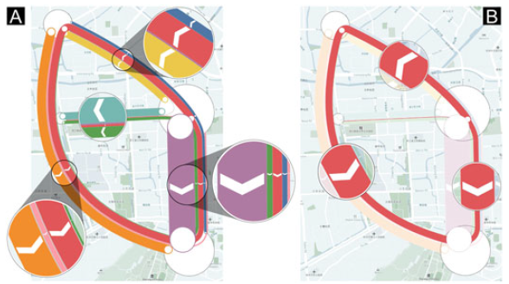
VU Visualisierung 2 (186.833) Implementation of Mulitlevel Visualization of Aggregated Geo-Networks Topic presentation
Case study on JamCas dataset from [1]
Xxx / xxx, Jessica Hieb / 12421440
Institute of Visual Computing & Human-Centered Technology, TU Wien, Austria
Notes:
< Exercise type> : 1. Research Paper Implementation​, 2. Technique Extension/Adaptation, 3. Dataset Visualization
In this template: 1. Research Paper Implementation​

Slide 2
Short Article Summary
Notes:
Summarize the algorithms and concepts described in the paper.
If space is available, put some representative image here
~ 1 minute

Slide 3
Concept
Notes:
Describe what you plan to implement – you do not need to and often should not stick 100% to the algorithm described in the paper.
If you do not stick closely to the paper, describe what you omit and / or what you will implement additionally.
The design and implementation effort should be proportional to the lab ECTS! Take existing libraries and online examples into account when estimating your effort!
If you have any open questions, put them here!
~1 minute

Slide 4
Implementation & Data
WebGPU / D3
Focus on Europe and data from 2024
Data sources: World Meteorological Organisation, Extreme Events in 2024: 2024 Extreme Events Dashboard.
Notes:
Describe how you plan to implement the work: which visualization or graphics libraries do you plan to use?
Do you have some data already? Describe the relevant aspects of the data (source, size, structure etc.)!
Which data preprocessing steps are necessary and which libraries do you plan to use?
If you do not have data yet, this is a good time to get feedback!
~1 minute

Slide 5
Group Name
Zikun Deng , Shifu Chen, Xiao Xie , Guodao Sun , Mingliang Xu , Di Weng , and Yingcai Wu
Multilevel Visual Analysis of Aggregate Geo-Networks
Journal / Proceedings (+ Issue / Volume)
2024
Notes:
This is the last slide that remains visible until the next group comes up.
A picture would be helpful to support the discussion ☺
Nothing to say here.

Slide 6
Sources
[1] Z. Deng et al., "Multilevel Visual Analysis of Aggregate Geo-Networks," in IEEE Transactions on Visualization and Computer Graphics, vol. 30, no. 7, pp. 3135-3150, July 2024.

